Slide 1


SMART INDIA HACKATHON 2024
TITLE PAGE
Problem Statement ID – SIH1743
Problem Statement Title- Parsing of Social Media Feeds
Theme- Miscellaneous
PS Category- Software
Team ID-
Team Name (Registered on portal)

Slide 2
Social Media Investigator (SMI)
Path
Finder
❖Proposed Solution (Describe your Idea/Solution/Prototype)
Proposed Solution
We have created a Social Media Investigator Tool (SMIT), designed to work on both Mobile and Desktop, which will help investigating officers expedite the digital evidence collection process from suspects’ social media platforms by automating data extraction (including screenshotting).
How it Addresses the Problem
SMIT will capture screenshots of all relevant data and organize them in a structured, documented format.
All the collected data can be presented in reports and Panchnamas.
SMIT will eliminate any chances of human error during the process.
Innovation
Automated Data Parsing and Screenshotting
Dual-Platform Compatibility
AI based OCR Technology
Uniqueness
Comprehensive Social Media Coverage
Structured Documentation and Reporting
Link to Prototype video: Click Here

Slide 3
























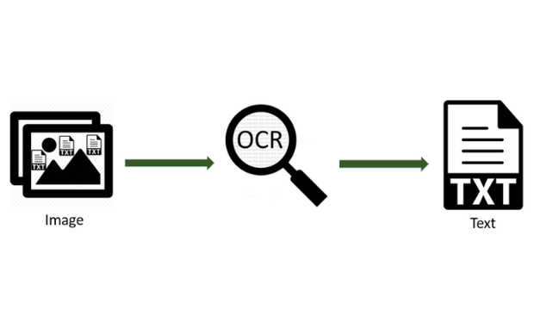

TECHNICAL APPROACH
Path
Finder
Software Tool
TECHNOLOGY STACK
1
Architecture Diagram
Same Procedure for all the Application
Frontend:
2
3
4
Backend:
SM Application
Selected Application
Valid login details
Posts ,Messages etc.
Screenshots
Database :
Mobile App:
illegal chats
Machine learning Model
Database
Report
5
Libraries:-
8
6
7
Legal Chats

Slide 4
FEASIBILITY AND VIABILITY
Path
Finder
FEASIBILITY
Technical Capability: The tool can be built using existing technologies like automation scripts, data parsing libraries, and AI, making it technically feasible.
Cross-Platform Support: Developing both Android and Windows versions is feasible, accommodating situations where social media accounts are inaccessible on desktops.
Specialized Modules: The tool can be customized for specific social media platforms, allowing for tailored data extraction and documentation.
VIABILITY
High Demand: There is a strong need for such tools in legal investigations, especially with the increasing importance of social media evidence.
Legal Compliance: The tool must comply with privacy laws, ensuring that data collection is ethical and admissible in court.
Efficiency Gains: Automation reduces human error and speeds up the investigative process, making the tool economically viable for law enforcement agencies.

Slide 5
IMPACT AND BENEFITS
Path
Finder
Potential impact on the target audience:
Improved efficiency & reduced manual effort
Increased accuracy & reduced bias
Data-driven decision-making
Enhanced safety & security
Benefits of the solution (social, economic, environmental, etc.)
Enhanced online safety through detection of cyberbullying.
Cost savings for law enforcement.
Reduced carbon footprint from automated processes

Slide 6
RESEARCH AND REFERENCES
Path
Finder
Details / Links of the reference and research work
https://www.researchgate.net/publication/330057971_Digital_Forensic_Investigation_of_Social_Media_Acquisition_and_Analysis_of_Digital_Evidence
"Automated Social Media Data Collection and Analysis" by Kim et al. (2019) in the Journal of Information Science
The Social Media Analysis Toolkit (SMAT) developed by the National Institute of Standards and Technology (NIST)
https://www.deccanherald.com/india/nia-cautions-people-about-fake-messages-circulating-on-social-media-on-its-behalf-2738308

